Slide 1
Bluetooth Low Energy (BLE)
Praveen Gnanasekaran and Saksham Sabharwal
ECEN 5613 - Embedded System Design
06 November 2016

Slide 2
What is BLE?
Low power, low cost wireless communication technology. A.k.a. BT Smart
Designed by Nokia (Wibree) in 2006, incorporated in Bluetooth 4.0 in 2010
Two types of BLE devices:
Single-mode (BLE or Bluetooth Smart)
Dual-mode (Bluetooth Smart Ready)
Throughput compromised for power efficiency
Suitable for sensor polling, control and monitoring applications
Unsuitable for large data transfer applications (such as media streaming)
Operates in the 2.4GHz ISM band (same as WiFi and Bluetooth Classic)
Notes:
Typical power consumption is low enough that it can be powered by a coin cell for many years. Battery life also depends on frequency of transmission.
Low cost since it does not have any processing parts, just a transceiver. Processing is done at the host location. Also, usage of 2.4GHz ISM band has no license requirements or fees.
Single-mode devices can communicate only with other BLE devices.
Dual-mode devices can communicate with BLE as well as Bluetooth Classic devices.
References:
Wikipedia - https://en.wikipedia.org/wiki/Bluetooth_low_energy
Overview and Evaluation of Bluetooth Low Energy Wireless Technology - http://www.mdpi.com/1424-8220/12/9/11734/htm

Slide 3
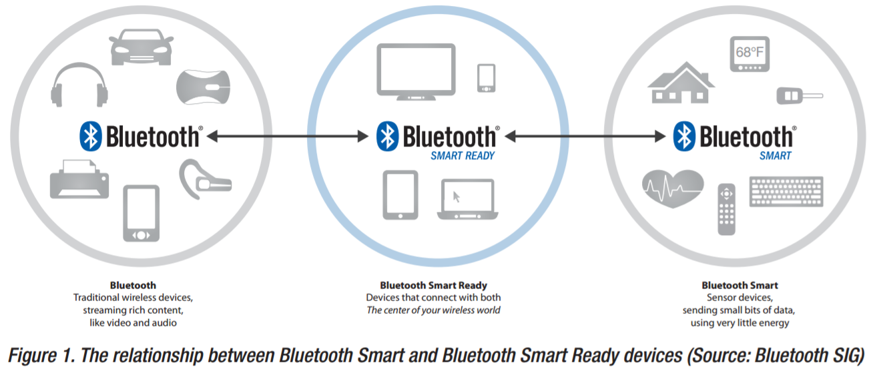
Bluetooth Classic, BLE and The IoT Connection
Fig.1 from TI White Paper - Three flavors of Bluetooth: Which one to choose?
Notes:
From a design perspective, the application needs (as well as power resources) decide which technology to use. Some examples below:
Bluetooth Classic - For applications where a constant-on, high throughput connection is required. More power consumption. Eg. Bluetooth stereo headsets, Bluetooth mouse.
Bluetooth Smart - For applications that require relatively low duty cycle. Less power consumption. Eg. Fitness trackers, Heart rate monitors, Home automation, Proximity tags.
Bluetooth Smart Ready - These devices act as a gateway between BT Classic and BLE devices.
References:
Three flavors of Bluetooth - http://www.ti.com/lit/wp/swry007/swry007.pdf

Slide 4
Bluetooth Classic, BLE and The IoT Connection
Technical Specification | Bluetooth Classic | Bluetooth Low Energy
Symbol Rate | 1-3 Mbps | 1 Mbps
Application Throughput | 0.7 - 2.1 Mbps | 305 kbps
Nodes/Active Slaves | 7 | Unlimited (Application dependent)
Latency (from non-connected state) | 100+ ms | < 6 ms
Security | 56/128-bit | 128-bit AES
Power Consumption | 1 (Reference value) | 0.01 to 0.5 (Use-case dependent)
Table.1 referenced from web resource: Classic Bluetooth vs. Bluetooth low energy
Notes:
BLE is an extension of Classic Bluetooth, not a competitor for replacement.
BLE is as an enabler of IoT. BLE devices interface to the Internet through Bluetooth Smart Ready devices such as smartphones, tablets or PCs. The main benefit of this approach is that the wireless devices can be simpler, lower cost and lower power than devices that would interface to the Internet directly (either through GSM/3G/LTE or Wi-Fi). Also, no extra infrastructure is required; the users already have the equipment needed to interface Bluetooth Smart devices to the Internet.
References:
Three flavors of Bluetooth - http://www.ti.com/lit/wp/swry007/swry007.pdf
Classic Bluetooth vs. Bluetooth low energy - http://www.mt-system.ru/sites/default/files/docs/documents/bluetooth_le_comparison.pdf

Slide 5
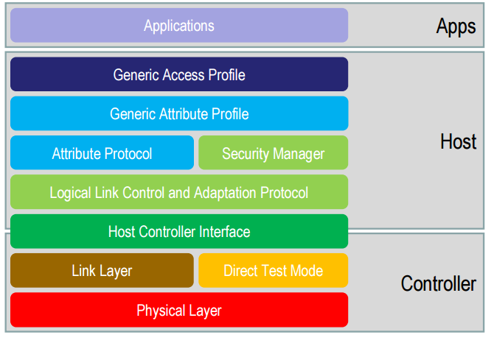
BLE Architecture
Fig. 2 Ref: J. Decuir, “Bluetooth 4.0: Low Energy” 2010, http://chapters.comsoc.org/vancouver/BTLER3.pdf
Notes:
Controller - Chip level to transmit and/or receive packets; has physical layer-uses GFSK to prevent energy from spreading
Link layer - To establish links, has advertising and data channels
Host: L2CAP (Logical Link Control and Adaptation Protocol) - Enables BLE to multiplex to 3 different channels, Security manager - Authentication and setting up secure connections, Attribute Protocol - Exposes the state data on a device
Profiles: GATT(relationship b/w profiles, services, characteristics) & GAP (How connection is made eg. b/w private devices)
Application Layer - 1. Characteristics - Bit of data with UUID, 2. Service - Human Readable, 3. Profile - Two or more services

Slide 6
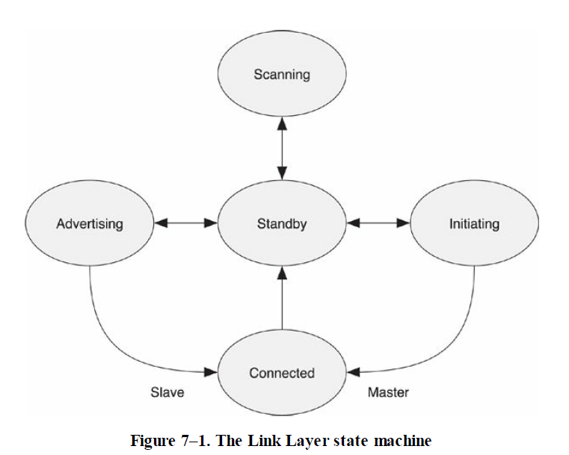
Link Layer State Machine
Fig. 3 Ref: Ch.7, Pg.69, R. Heydon, “Bluetooth Low Energy: The Developer's Handbook”, Prentice Hall, 2012
Notes:
Standby - Default state after power On
Advertising state - If device wants to be discoverable or connectable; should have receiver as minimum, can have both receiver and transmitter
Scanning state - Active (can transmit to get more info) and Passive (no transmission, only receiving)
Initiating state - To initiate a connection to another device, the link Layer must first be placed into the initiating state (only for master)
Connected state - 2 sub-states:
Master: Device that becomes a master must initiate the connection to the peer device.
Slave: Device that becomes a slave must have been advertising to the peer device.

Slide 7
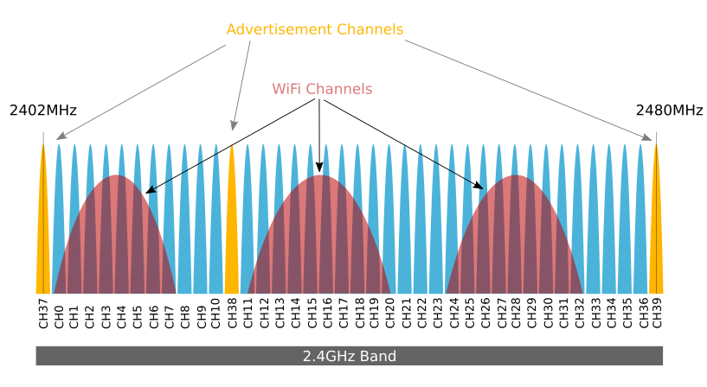
Link Layer Channels
2.4 GHz band - same as WiFi
40 channels - 37 (Data) + 3 (Adv.)
Adaptive Frequency Hopping
Fig. 4 Ref: Argenox Technologies, A BLE Advertising Primer
Notes:
37 data channels (in blue) and 3 advertisement channels (yellow)
Types of advertising - General, Direct, Non-connectable, Discoverable
Adaptive Frequency Hopping - Identifies interference channels, remaps data channels from known bad channels to known good channels.
BLE - GFSK (Gaussian Frequency Shift Key) modulation index = 0.5
Bluetooth Classic - GFSK modulation index = 0.3
Enables faster setup times, transfer speeds (for the same transmit power) for BLE
Allowing better range / robustness
Short packets together with GFSK gives lowest complexity transmitter / receiver

Slide 8
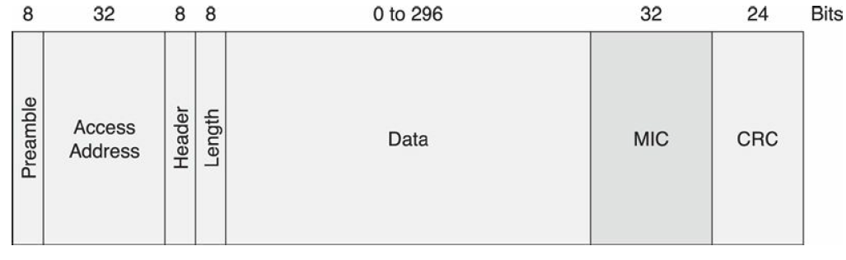
Packet Structure
Fig. 5 - Encrypted Packet Structure
Fig. Ref: Ch.7, Pg.107, R. Heydon, “Bluetooth Low Energy: The Developer's Handbook”, Prentice Hall, 2012
Notes:
2 Fixed preambles (01010101 or 10101010) to prevent random noise to be misinterpreted as access address. Radio is expected to pick up signals from wide range (-10 to -90dBm)
Access address 32 bits - Upto 2^32 devices available for communication
Header - Determines if it’s advertisement or data packet
Length of Payload is a check condition
Payload - Connection or data information
MIC (Message Integrity Check) - Only present if data is encrypted
CRC - 24-bit length (Optimized between Robustness (32-bit length CRC) and Power saving (16-bit length CRC))
Master always determines Access address, CRC

Slide 9
Profiles - GAP and GATT
Generic Access Profile (GAP) - Used for establishing connection while pairing
Discovery procedures
Client initiated
Server initiated
Generic Attribute Profile (GATT) - Used for information interchange after pairing
Types of attributes
Units
Attribute types
Characteristic descriptor
Characteristic type
Notes:
Discovery procedures- Client should discover primary services. Then all services associated with it can be discovered
client-initiated procedures- reading and writing characteristic values and descriptors
Server-Initiated Procedures- notifications(no flow control, no ack from client needed) and indications(have flow control ie. should wait for ack from client)
Type of attribute is defined by service UUIDs- eg temp, batt level
Units- eg, bpm and degree C or degree F
Attribute types- primary, secondary ,include/characteristic
Characteristic descriptor- any additional data .eg a value that describes the format of data
Characteristic types- additional description from service UUIDs

Slide 10

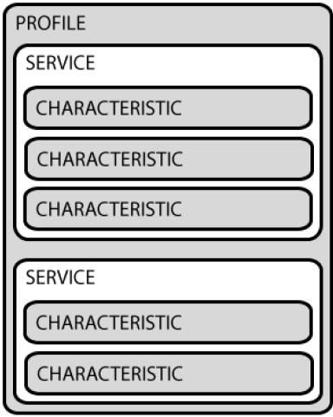
Profiles, Services and Characteristics
Rigid profiles in Bluetooth - Hands free headset problem
BLE - Immutable services. Interchangeable profiles.
Fig. 6 - Profile and Service
Fig. Ref: Pg.9, K. Townsend, “Introduction to Bluetooth Low Energy”, Adafruit Learning System, 2014
Notes:
Studies show using BT causes headaches : http://www.ijcsit.com/docs/Volume%205/vol5issue02/ijcsit20140502120.pdf, http://www.techulator.com/resources/8616-Impact-using-Bluetooth-headsets.aspx
Services (immutable) and profiles - Part of attribute layer.
BLE uses 3 different kinds of states - internal, external and abstract states
Primary and secondary service for battery profile - Primary: Battery Level (percentage); Secondary: Battery Temperature

Slide 11
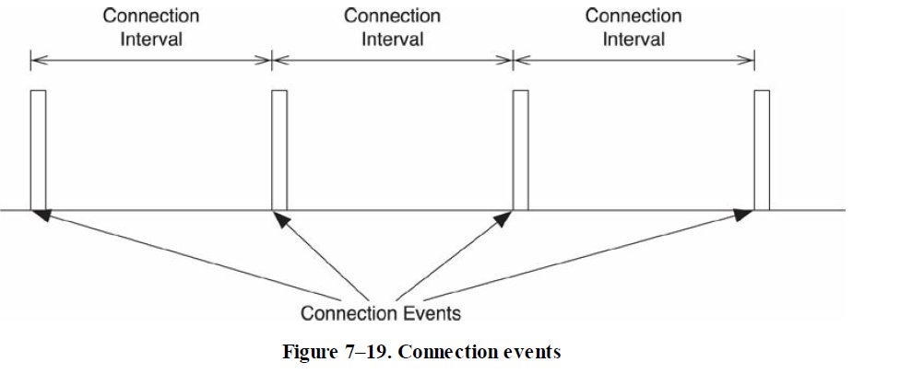
Saving Power: Slave Latency & Lazy Acknowledgement
Connectionless Model - Connection is established only during data transmission, and terminated immediately afterwards.
Slave Latency - No. of connection intervals that a slave can ignore and remain in sleep, while still being connected to master.
Lazy ACK - BLE acknowledgement scheme does not require devices to send immediate ACK after each transmission.
Fig. 7
Ref: Ch.7, Pg.96, R. Heydon, “Bluetooth Low Energy: The Developer's Handbook”, Prentice Hall, 2012
Notes:
If the radio is doing something, even if it’s nothing more than checking whether it needs to send or receive something, it’s using energy. Also, it is important to reduce the time required to do anything useful. So radio is optimized greatly.
Slave Latency - Constant acks from slave to indicate that it is alive are not necessary.
Window Widening - Peripheral should listen 7.5ms before and after its expected connection time due to clock accuracy mismatch between slave and master.

Slide 12
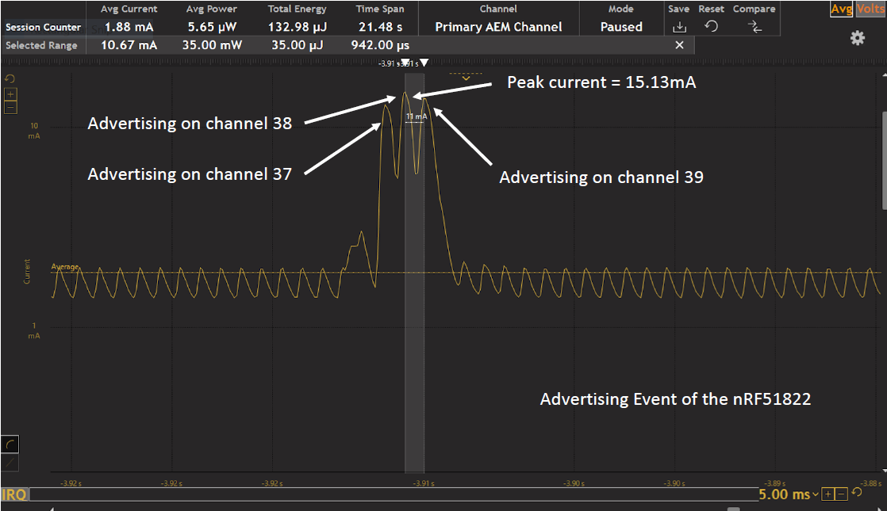
Ref: Lecture 11, Keith Graham, ECEN 5023 - Mobile Computing and IoT Security. September 29, 2016.
Notes:
Connectionless model
Here the slave has useful data to be transmitted. It hence advertises thrice, searching for the master. Since, the master does not connect, the slave goes to sleep instead of trying repeatedly to connect. This is an example of connectionless model

Slide 13
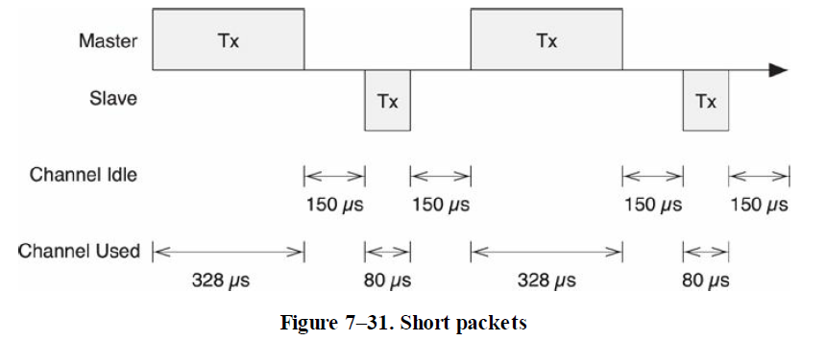
Low Power Design
Asymmetric Design Philosophy - Only the central device is rigorously defined.
Some characteristics of low power design: Short packets, High physical bit-rate, Low overhead, Optimized ACK scheme, Single channel connection events, Subrating connection events
Fig. Ref: Ch.7, Pg.124, R. Heydon, “Bluetooth Low Energy: The Developer's Handbook”, Prentice Hall, 2012
Notes:
Central device is “rigorously defined” - All processing happens here, peripherals are merely radios.
High bit-rate: Short, quick bursts of data packets, radio doesn’t get heated (radio circuitry is more complicated than Bluetooth)
Low overhead: Unencrypted transmission can be up to 51% more efficient than encrypted (without or with MIC-message integrity check)
Optimized ACK: Slave can ACK during the next transmit that it has received data from a previous connection
Single channel connection events: All connections make and break within one event
Subrating: Slave can ignore master requests (slave latency). Slave latency shouldn’t be longer than supervision timeout or master will think that the slave is dead.
Power Analysis:
The longest packet in an Advertising Event is 378 us
The longest packet in a Connection Event is 328 us
150 us between transmission is to enable cool down of radio. Radio uses CMOS, so a base amount of current/energy is defined for the radio
BLE Duty cycle= 58%
Bluetooth Duty cycle = 72%
So faster connection times for BLE as compared to Bluetooth

Slide 14
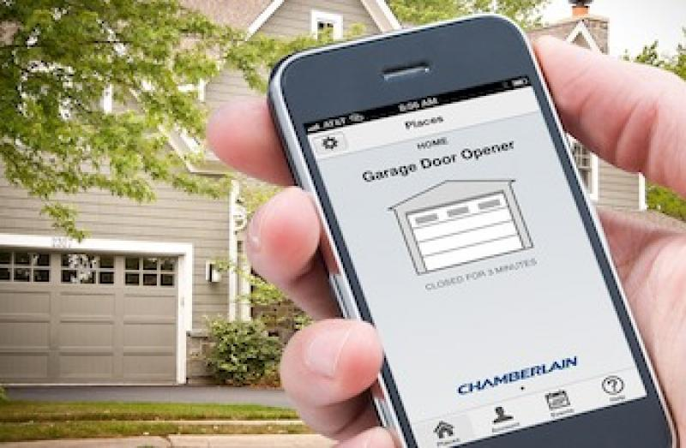
BLE Security
Bluetooth garage door security issue
BLE supports 128-bit AES encryption
Shared Secrets
Temporary Key
Man-in-the-middle attacks
Short-term Key
Long-term Key
Identity Resolving Key
Connection Signature Resolving Key
Notes:
Temporary Key: During pairing, set to a value that is determined by the pairing algorithm and used to calculate the Short-term key
Just Works - TK is zero
Passkey - Used when both sides have display and inputs like a keyboard
Out of band - Used to transfer keys on frequency other than 2.4Ghz, like NFC
Short-term Key: Used as the key for encrypting a connection the very first time two devices pair
Long-term Key: is distributed once the initial pairing procedure has encrypted the connection
Identity Resolving Key: To have privacy, advertising address changes randomly (walking down the hallway example) For trusted devices to know what address to look for, IRK is used
Connection Signature Resolving Key: Gives receiving device the ability resolve a signature and therefore authenticate the sender of the message

Slide 15
Design Constraints and Solutions
Constraints
Radio circuitry: More complex than conventional BT to be more stable
Reuse Bluetooth RF Band: Lots of traffic due to WiFi and BT devices
Smaller batteries: To ensure lower costs and smaller designs
Solutions
Efficient packet structures: So radio at peak power is on for lesser time
Reusing RF: BLE only needs approx. 60% of RF silicon area compared to BT. Can also use same antenna as BT (and possibly Wi-Fi) and can time division multiplex with BT
Low peak power in rx and tx using capacitor in parallel with coin cells
Notes:
Constraint 1: Antenna should be able to detect signals for -10 to -90 dBm range. Therefore, more stability required.
Low peak power as capacitor limits the peak current that can be drawn. Using a capacitor here is advantageous as using only a battery would result in more current being drawn.
References:
TI application note SWRA349 - Coin cells and peak current draw - http://www.ti.com/lit/wp/swra349/swra349.pdf
BLE CSR Presentation - https://www.bluetooth.org/DocMan/handlers/DownloadDoc.ashx?doc_id=227336

Slide 16
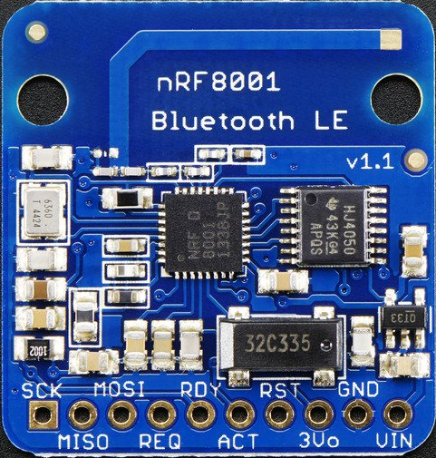
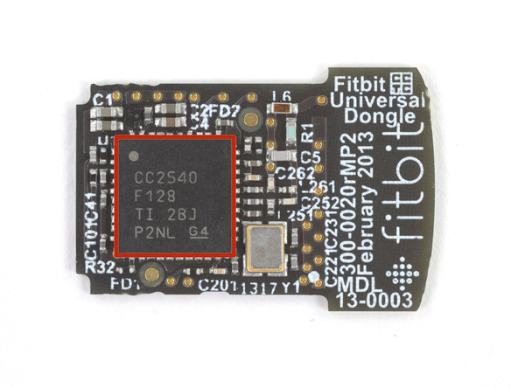
BLE Hardware Example
Fitbit Flex BLE Teardown
The nRF8001 module works as a BLE peripheral inside the Fitbit tracker worn by the user
It is controlled by an STM Ultra-low-power ARM Cortex-M3 MCU (not pictured)
The TI CC2540F128 is present in the Fitbit dongle, is capable of running the BLE Protocol stack
Nordic nRF8001 BLE Breakout Board
TI CC2540F128 2.4 GHz BLE SoC - 8051 uC Core
Notes:
Some common BLE applications are:
Fitness trackers, Heart rate monitors, Home automation, Proximity tags.
References:
https://www.adafruit.com/product/1697
https://www.ifixit.com/Teardown/Fitbit+Flex+Teardown/16050
http://www.ti.com/lit/ds/symlink/cc2540.pdf

Slide 17
References
Bluetooth Low Energy: The Developer's Handbook, Robin Heydon, Prentice Hall, 2012
Overview and Evaluation of Bluetooth Low Energy: An Emerging Low-Power Wireless Technology, Gomez, Oller, Paradells, 2012
Bluetooth v4.2 Specification, Bluetooth Special Interest Group, 2014
Adafruit Learning System: Introdution to Bluetooth Low Energy, Kevin Townsend
Three flavors of Bluetooth: Which one to choose? - Texas Instruments application note SWRY007
A BLE Advertising Primer, Argenox Technologies

